Slide 1
CHAPTER 2
COLORS

Slide 2


PRACTICE 1
Find 4 suitable colors for each word meaning
10 MIN
INDIV
Creative
Young
Rich/Wealthy
Happy
Dangerous
Shy
Traditional

Slide 3
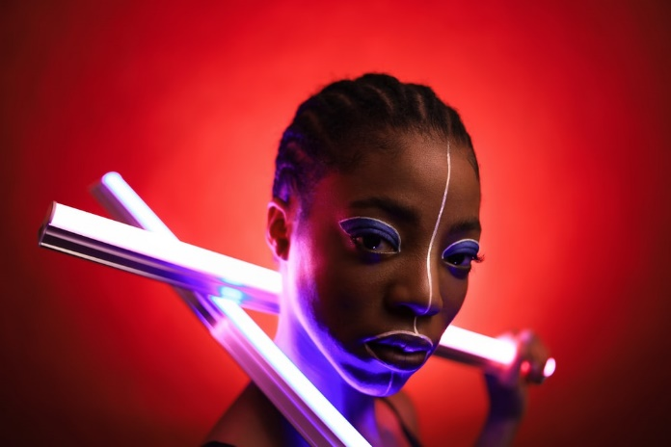
PRACTICE 2
Create a color palette from a photograph
10 MIN
INDIV
Select a picture from this website : https://unsplash.com/
Select 5 relevant colors related to the picture
Example :

Slide 4
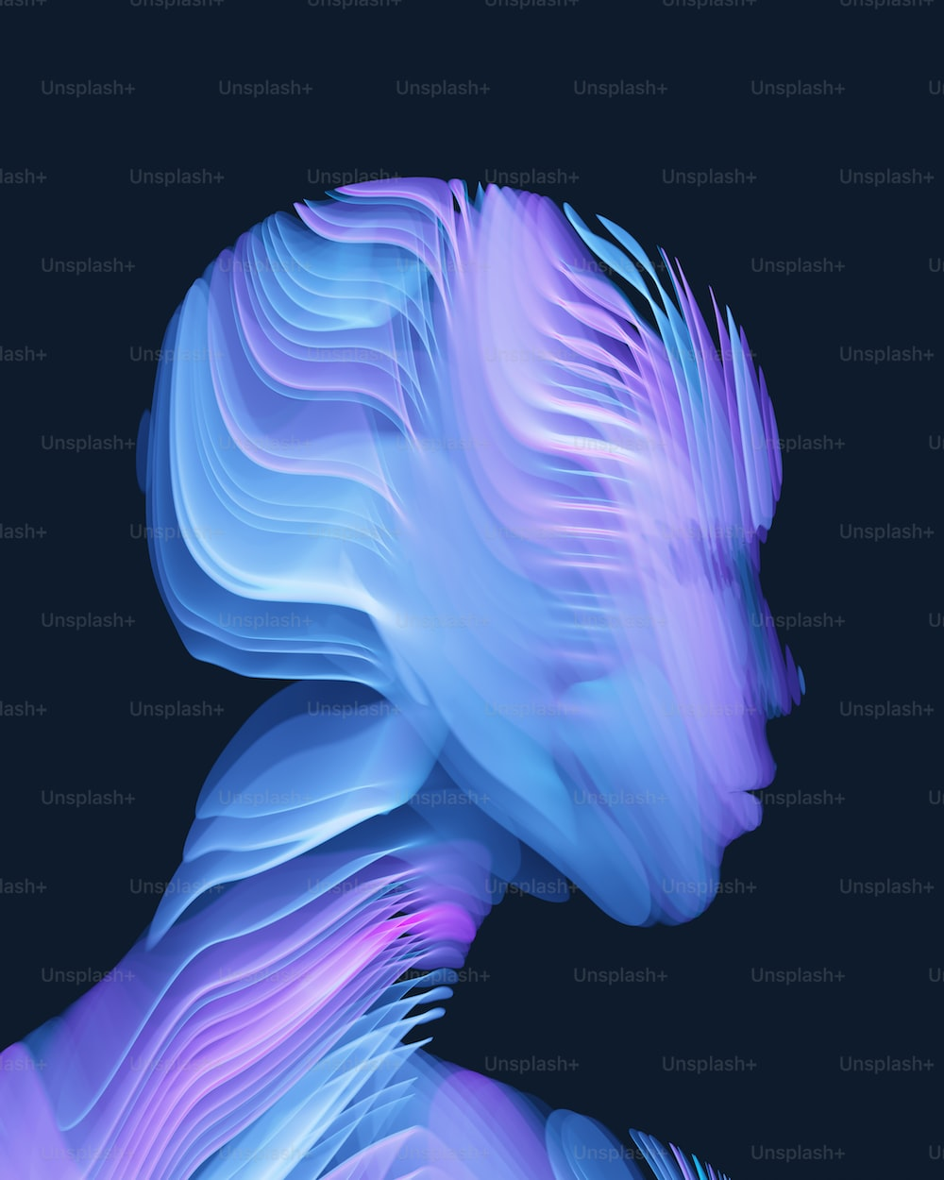
PRACTICE 2
Create a color palette from a photograph
10 MIN
INDIV

Slide 5

PRACTICE 3
Find the best color palette
for a toy store website
10 MIN
INDIV
using the wheel and the color meaning book
Define your color palette :
using an image

Slide 6

PRACTICE 2
Create a color palette from a photograph
10 MIN
INDIV

